Slide 1
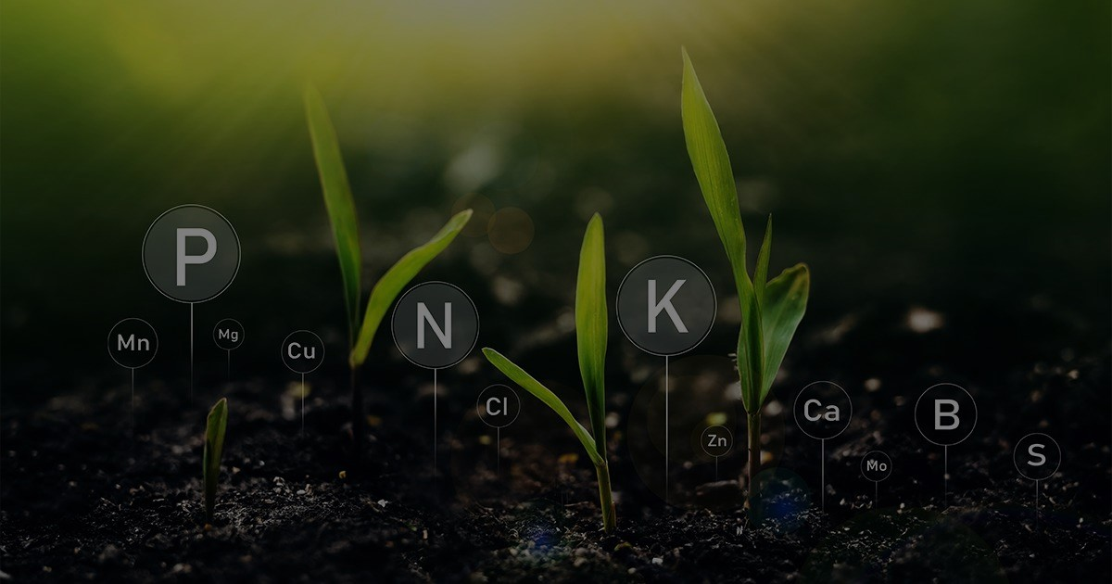
Soil Analysis and Crop Recommendation System
A system that addresses limited agricultural productivity in Malawi by offering an understanding of soil conditions and tailored recommendations based on soil testing results.

Slide 2

Problem Statement
Misuse of agricultural resources that leads to terrestrial eutrophication
Low crop production, due to unhealthy soil and In accurate soil test results.
Soil Healthy —-> Crop Growth

Slide 3






Solution
A Digital Tool that collects soil Contents(major nutrients) using sensors and recommends the most suitable crop based on the soil healthy.
Most accurate and Access to results instantly.
BASICALLY

Slide 4
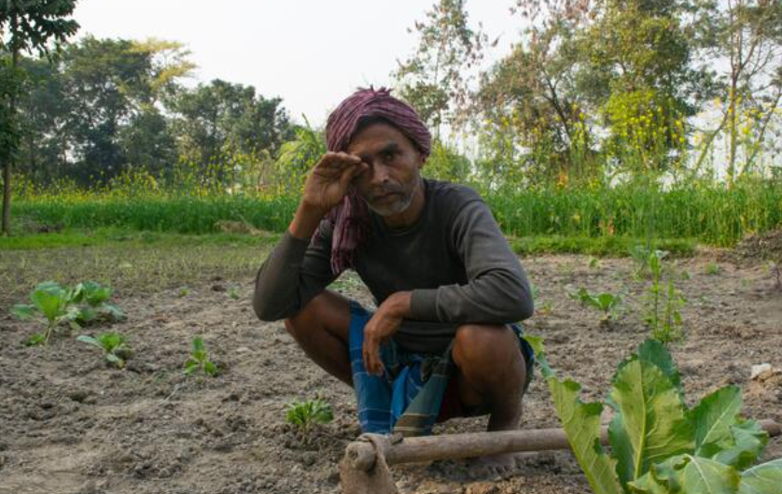

Current State
Limited crop yield
Approximately 65% of accurate soil testing results from Soil testing labs
Inefficient use of farming resources

Slide 5
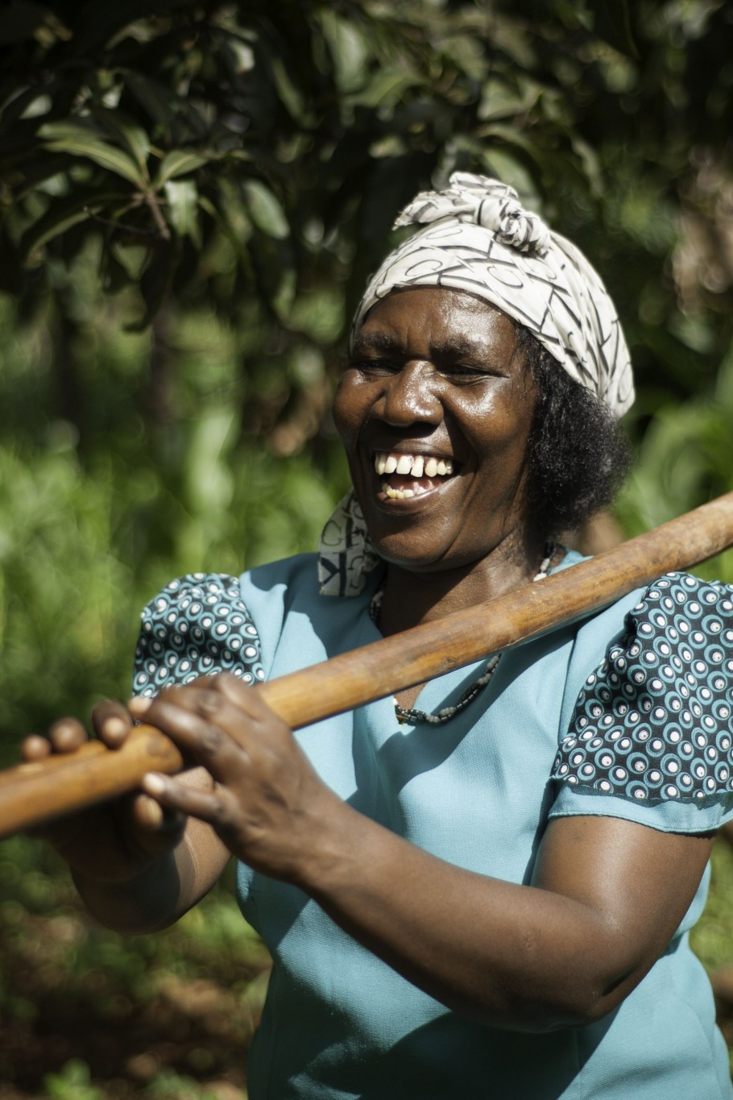
Future State
At least 96% accuracy of soil
testing results
Optimal use of Agriculture resources
Increased crop yield

Slide 6
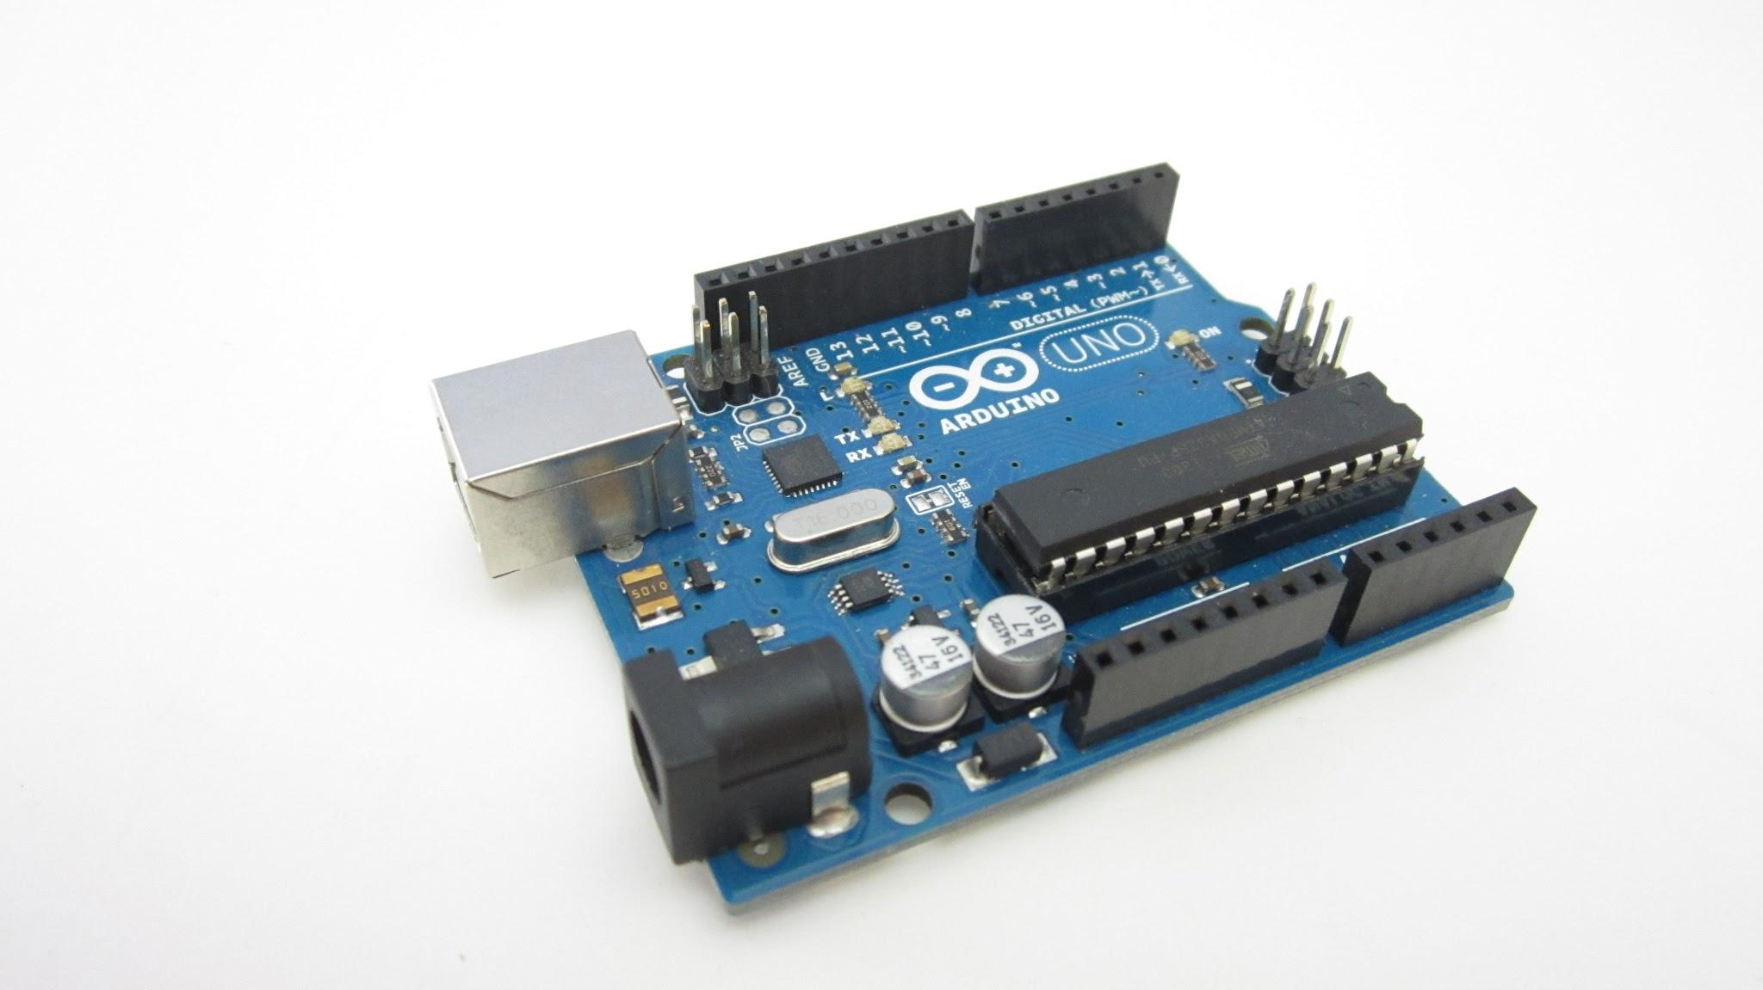
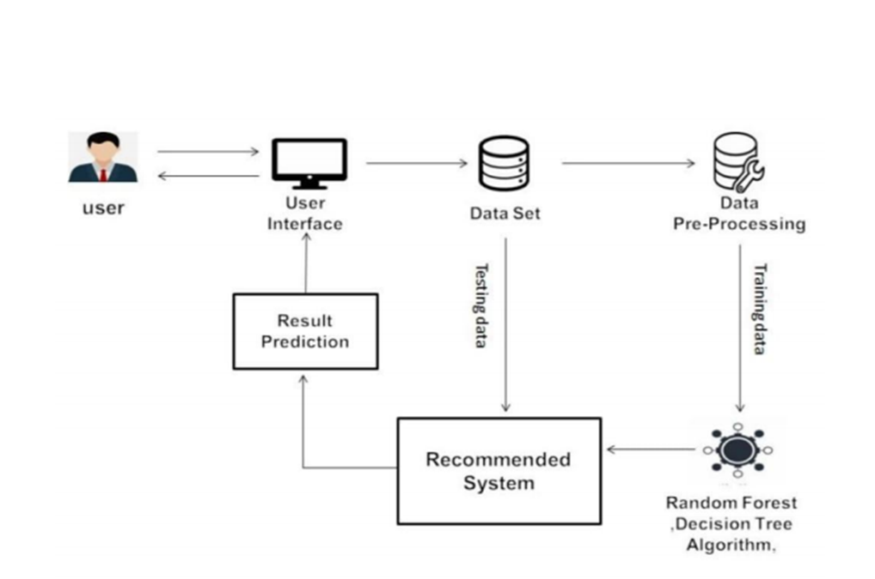
System Model
Node McU
SOIL PH sensor
Temperature sensor
Moisture
sensor
NPK sensor
soil/Land
SOIL/LAND

Slide 7
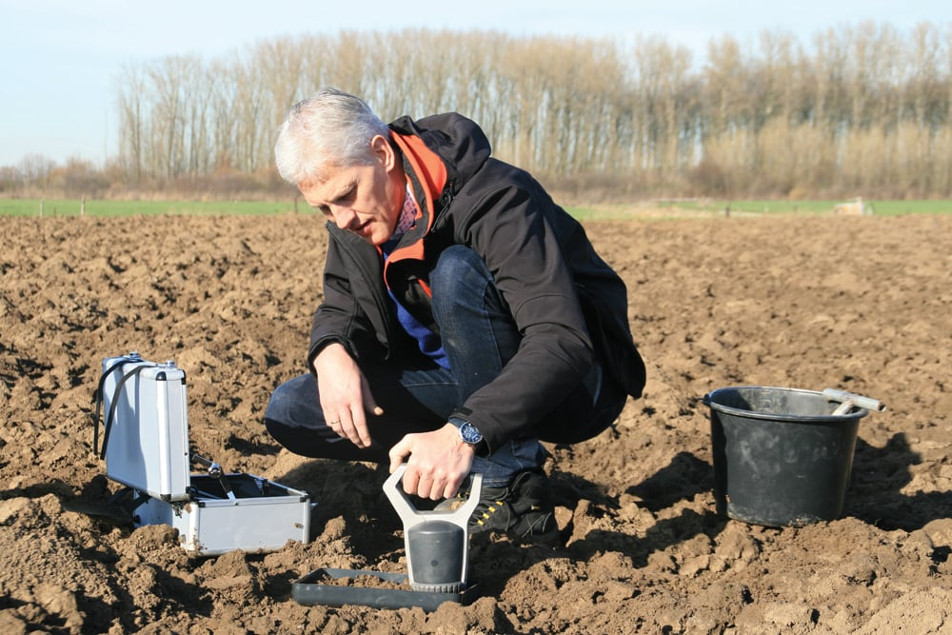
Competitors
International level : Nutri Scan, A company from Canada however?
National Level :
AgriLabs??
We are not eliminating the need to use labs
But complimenting by making their work easier.

Slide 8
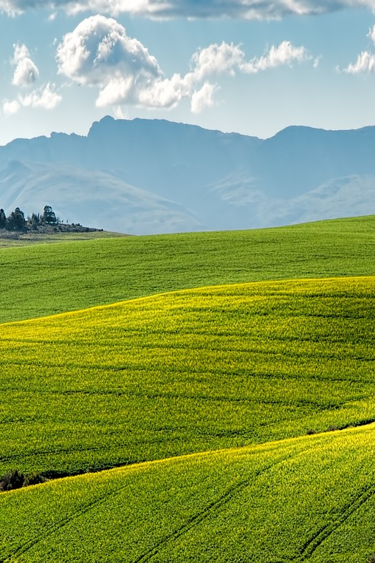
PROGRESS
Created a Progressive web app running
Trained our model with the available dataset
Firebase up and running
All IOT components physically connected and functioning
WORKING ON
Ensuring accuracy of system
Connecting
arduino->internet->firebase->website

Slide 9
Unique Selling Point
Holistic : Integration of Arduino and multiple sensors for real-time analysis in a single system.
Addresses limited agricultural productivity in Malawi
Tailored recommendations based on soil conditions
User-friendly website presenting nutrient information

Slide 10
Thank you for your time🙂

